Slide 1
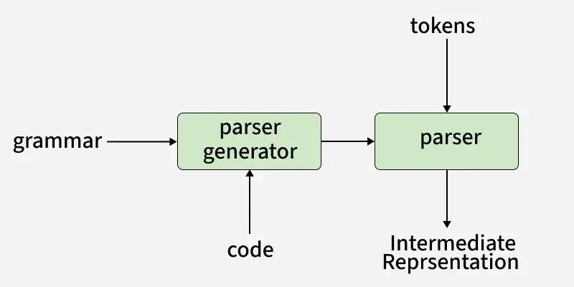
Parsing – Introduction to Parsers
Parsing, also known as syntactic analysis, is the process of analyzing a sequence of tokens to determine the grammatical structure of a program. It takes the stream of tokens, which are generated by a lexical analyzer or tokenizer, and organizes them into a parse tree or syntax tree.
The parse tree visually represents how the tokens fit together according to the rules of the language’s syntax. This tree structure is crucial for understanding the program’s structure and helps in the next stages of processing, such as code generation or execution.

Slide 2
What is the Role of Parser?
A parser performs syntactic and semantic analysis of source code, converting it into an intermediate representation while detecting and handling errors.
Context-free syntax analysis: The parser checks if the structure of the code follows the basic rules of the programming language (like grammar rules). It looks at how words and symbols are arranged.
Guides context-sensitive analysis: It helps with deeper checks that depend on the meaning of the code, like making sure variables are used correctly. For example, it ensures that a variable used in a mathematical operation, like x + 2, is a number and not text.
Constructs an intermediate representation: The parser creates a simpler version of your code that’s easier for the computer to understand and work with.
Produces meaningful error messages: If there’s something wrong in your code, the parser tries to explain the problem clearly so you can fix it.
Attempts error correction: Sometimes, the parser tries to fix small mistakes in your code so it can keep working without breaking completely.

Slide 3
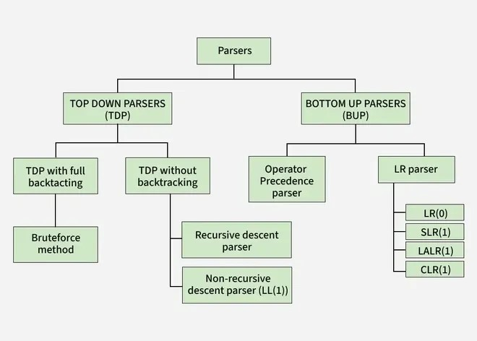
Types of Parsing
The parsing is divided into two types, which are as follows:
Top-down Parsing
Bottom-up Parsing

Slide 4
Top-Down Parsing
Top-down parsing is a method of building a parse tree from the start symbol (root) down to the leaves (end symbols). The parser begins with the highest-level rule and works its way down, trying to match the input string step by step.
Process: The parser starts with the start symbol and looks for rules that can help it rewrite this symbol. It keeps breaking down the symbols (non-terminals) into smaller parts until it matches the input string.
Leftmost Derivation: In top-down parsing, the parser always chooses the leftmost non-terminal to expand first, following what is called leftmost derivation. This means the parser works on the left side of the string before moving to the right.
Other Names: Top-down parsing is sometimes called recursive parsing or predictive parsing. It is called recursive because it often uses recursive functions to process the symbols.
Top-down parsing is useful for simple languages and is often easier to implement. However, it can have trouble with more complex or ambiguous grammars.
Top-down parsers can be classified into two types based on whether they use backtracking or not:
.

Slide 5
1. Top-down Parsing with Backtracking
In this approach, the parser tries different possibilities when it encounters a choice, If one possibility doesn’t work (i.e., it doesn’t match the input string), the parser backtracks to the previous decision point and tries another possibility.
Example: If the parser chooses a rule to expand a non-terminal, and it doesn’t work, it will go back, undo the choice, and try a different rule.
Advantage: It can handle grammars where there are multiple possible ways to expand a non-terminal.
Disadvantage: Backtracking can be slow and inefficient because the parser might have to try many possibilities before finding the correct one
2. Top-down Parsing without Backtracking
In this approach, the parser does not backtrack. It tries to find a match with the input using only the first choice it makes, If it doesn’t match the input, it fails immediately instead of going back to try another option.
Example: The parser will always stick with its first decision and will not reconsider other rules once it starts parsing.
Advantage: It is faster because it doesn’t waste time going back to previous steps.
Disadvantage: It can only handle simpler grammars that don’t require trying multiple choices.
Read more about classification of top-down parser.

Slide 6
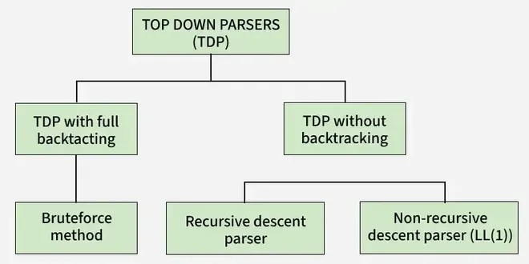
Classification of Top-Down Parsing

Slide 7
Recursive Descent Parsing
Recursive Descent Parsing is a top-down parsing technique used to analyze the syntax of a given input string based on a set of grammar rules. It uses a set of recursive procedures (or functions) to process each non-terminal in the grammar and try to match the input string.
Here’s how it works:
Start with a Non-terminal.
Check the first possible option (alternative) for the Non-terminal and try to match it with the input string.
If it doesn’t match, move to the second option and try again.
Continue this process for each option until you find a match.
If at least one option matches the input string, the parsing is successful.
In simple terms, it’s like trying different combinations to find the right one that works for the input string.
A recursive descent parser is a top-down parser that processes input based on a set of recursive functions, where each function corresponds to a grammar rule. It parses the input from left to right, constructing a parse tree by matching the grammar’s production rules. This parser is simple to implement and is suitable for LL(1) grammars, where decisions can be made based on a single lookahead token. While straightforward, recursive descent parsers struggle with left-recursive grammars and may require grammar transformations to handle such cases effectively.

Slide 8
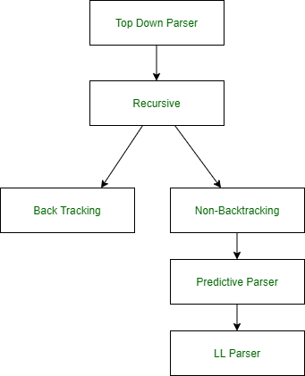
Example:
Before removing left recursion | After removing left recursion
E –> E + T | T T –> T * F | F F –> ( E ) | id | E –> T E’ E’ –> + T E’ | e T –> F T’ T’ –> * F T’ | e F –> ( E ) | id
Predictive Parser in Compiler Design
In this, we will cover the overview of Predictive Parser and mainly focus on the role of Predictive Parser. And will also cover the algorithm for the implementation of the Predictive parser algorithm and finally will discuss an example by implementing the algorithm for precedence parsing. Let’s discuss it one by one.

Slide 9
Predictive Parser : A predictive parser is a recursive descent parser with no backtracking or backup. It is a top-down parser that does not require backtracking. At each step, the choice of the rule to be expanded is made upon the next terminal symbol. Consider
A -> A1 | A2 | ... | An
If the non-terminal is to be further expanded to ‘A’, the rule is selected based on the current input symbol ‘a’ only.
Predictive Parser Algorithm :
Make a transition diagram(DFA/NFA) for every rule of grammar.
Optimize the DFA by reducing the number of states, yielding the final transition diagram.
Simulate the string on the transition diagram to parse a string.
If the transition diagram reaches an accept state after the input is consumed, it is parsed.
Consider the following grammar –
E->E+T|T T->T*F|F F->(E)|id
After removing left recursion, left factoring
E->TT' T'->+TT'|ε T->FT'' T''->*FT''|ε F->(E)|id

Slide 10
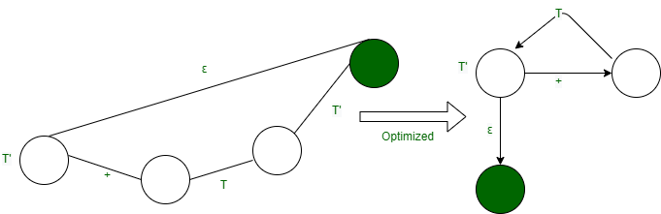

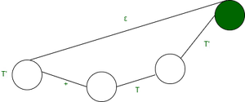
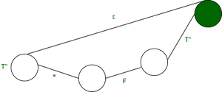
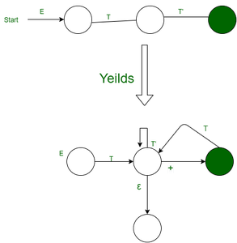

STEP 2: Optimize the DFA by decreases the number of states, yielding the final transition diagram.
T’->+TE’|ε
STEP 1: Make a transition diagram(DFA/NFA) for every rule of grammar.
E->TT’
T’->+TT’|ε
It can be optimized ahead by combining it with DFA for E’->TE’
T”->*FT”|ε
F->(E)|id

Slide 11
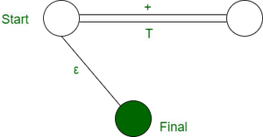
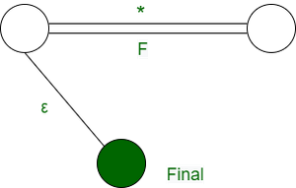
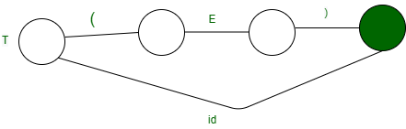
Accordingly, we optimize the other structures to produce the following DFA
STEP 3: Simulation on the input string. Steps involved in the simulation procedure are:
Start from the starting state.
If a terminal arrives consume it, move to the next state.
If a non-terminal arrive go to the state of the DFA of the non-terminal and return on reached up to the final state.
Return to actual DFA and Keep doing parsing.
If one completes reading the input string completely, you reach a final state, and the string is successfully parsed

Slide 12
Important points about recursive descent parsers
Top-Down Parsing: It starts from the start symbol and recursively applies grammar rules to break down the input.
One Function per Non-Terminal: Each grammar rule has a corresponding function in the parser, making the implementation straightforward.
Uses Recursion: The parser calls functions within themselves to process different parts of the input, matching the recursive nature of grammar rules.
Works Best with LL(1) Grammars: It’s most effective for grammars that can be parsed with a single token lookahead, typically simple, non-left-recursive grammars.
Easy to Implement: The structure is easy to follow and implement, making it a good choice for small compilers or interpreters.
Error Handling: It can detect syntax errors and report them, making it useful for debugging input strings.

Slide 13
LL(1) or Table Driver or Predictive Parser
LL(1) parsing is a way to analyze a sentence in a programming language and check if it follows the correct structure. The name LL(1) has a meaning:
The first L means reading the input from Left to Right.
The second L means creating the Left-most Derivation (building the structure step by step from the left side).
The 1 means looking one step ahead in the input to decide what to do next.
Rules for LL(1) Parsing
To work properly, an LL(1) parser needs clear and simple grammar:
No left recursion (rules must not refer to themselves at the beginning).
No common prefixes (if two rules start the same way, they should be rewritten to avoid confusion).
No ambiguity (there must be only one way to build the sentence).
Because LL(1) parsing is predictable and fast, it is used in compilers and interpreters to check if code is written correctly.
What is LL(1) Parsing?
Here the 1st L represents that the scanning of the Input will be done from the Left to Right manner and the second L shows that in this parsing technique, we are going to use the Left most Derivation Tree. And finally, the 1 represents the number of look-ahead, which means how many symbols you will see when you want to make a decision.

Slide 14
Conditions for an LL(1) Grammar
To construct a working LL(1) parsing table, a grammar must satisfy these conditions:
No Left Recursion: Avoid recursive definitions like A -> A + b.
Unambiguous Grammar: Ensure each string can be derived in only one way.
Left Factoring: Make the grammar deterministic, so the parser can proceed without guessing.
Algorithm to Construct LL(1) Parsing Table
Step 1: First check all the essential conditions mentioned above and go to step 2.
Step 2: Calculate First() and Follow() for all non-terminals.
First(): If there is a variable, and from that variable, if we try to drive all the strings then the beginning Terminal Symbol is called the First.
Follow(): What is the Terminal Symbol which follows a variable in the process of derivation.
Step 3: For each production A –> α. (A tends to alpha)
Find First(α) and for each terminal in First(α), make entry A –> α in the table.
If First(α) contains ε (epsilon) as terminal, then find the Follow(A) and for each terminal in Follow(A), make entry A –> ε in the table.
If the First(α) contains ε and Follow(A) contains $ as terminal, then make entry A –> ε in the table for the $.

Slide 15
Step 1: The grammar satisfies all properties in step 1.
Step 2: Calculate first() and follow().
Find their First and Follow sets:
o construct the parsing table, we have two functions:
In the table, rows will contain the Non-Terminals and the column will contain the Terminal Symbols. All the Null Productions of the Grammars will go under the Follow elements and the remaining productions will lie under the elements of the First set.
Now, let’s understand with an example.
Example 1: Consider the Grammar:
E --> TE' E' --> +TE' | ε T --> FT' T' --> *FT' | ε F --> id | (E) *ε denotes epsilon
Step 1: The grammar satisfies all properties in step 1.
Step 2: Calculate first() and follow().
Find their First and Follow sets:
 | First | Follow
E –> TE’ | { id, ( } | { $, ) }
E’ –> +TE’/ε | { +, ε } | { $, ) }
T –> FT’ | { id, ( } | { +, $, ) }
T’ –> *FT’/ε | { *, ε } | { +, $, ) }
F –> id/(E) | { id, ( } | { *, +, $, ) }

Slide 16
Step 3: Make a parser table.
Now, the LL(1) Parsing Table is:
 | id | + | * | ( | ) | $
E | E –> TE’ |  |  | E –> TE’
E’ |  | E’ –> +TE’ |  |  | E’ –> ε | E’ –> ε
T | T –> FT’ |  |  | T –> FT’
T’ |  | T’ –> ε | T’ –> *FT’ |  | T’ –> ε | T’ –> ε
F | F –> id |  |  | F –> (E)
As you can see that all the null productions are put under the Follow set of that symbol and all the remaining productions lie under the First of that symbol.
Note: Every grammar is not feasible for LL(1) Parsing table. It may be possible that one cell may contain more than one production.
Let’s see an example.
Example 2: Consider the Grammar
S --> A | a A --> a

Slide 17
Step 1: The grammar does not satisfy all properties in step 1, as the grammar is ambiguous. Still, let’s try to make the parser table and see what happens
Step 2: Calculating first() and follow()
Find their First and Follow sets:
 | First | Follow
S –> A/a | { a } | { $ }
A –>a | { a } | { $ }
step 3: Make a parser table.
Parsing Table:
 | a | $
S | S –> A, S –> a
A | A –> a

Slide 18
Example 3: Consider the Grammar
S -> (L) | a L -> SL' L' -> )SL' | ε
Step1: The grammar satisfies all properties in step 1
Step 2: Calculating first() and follow()
 | First | Follow
S | ( , a | $, )
L | ( , a | )
L’ | ), ε | )
Step 3: Making a parser table
Parsing Table:
 | ( | ) | a | $
S | S -> (L) |  | S -> a
L | L -> SL’ |  | L -> SL’
L’ |  | L’->(SL’ L’->ε

Slide 19
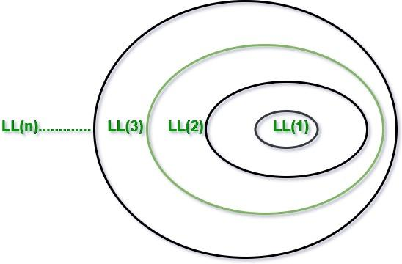
Advantages of Construction of LL(1) Parsing Table
Clear Decision-Making: With an LL(1) parsing table, the parser can decide what to do by looking at just one symbol ahead. This makes it easy to choose the right rule without confusion or guessing.
Fast Parsing: Since there’s no need to go back and forth or guess the next step, LL(1) parsing is quick and efficient. This is useful for applications like compilers where speed is important.
Easy to Spot Errors: The table helps identify errors right away. If the current symbol doesn’t match any rule in the table, the parser knows there’s an error and can handle it immediately.
Simple to Implement: Once the table is set up, the parsing process is straightforward. You just follow the instructions in the table, making it easier to build and maintain.
Good for Predictive Parsing: LL(1) parsing is often called “predictive parsing” because the table lets you predict the next steps based on the input. This makes it reliable for parsing programming languages and structured data.

Slide 20
Bottom-Up Parsing
Bottom-up parsing is a method of building a parse tree starting from the leaf nodes (the input symbols) and working towards the root node (the start symbol). The goal is to reduce the input string step by step until we reach the start symbol, which represents the entire language.
Process: The parser begins with the input symbols and looks for patterns that can be reduced to non-terminals based on the grammar rules. It keeps reducing parts of the string until it forms the start symbol.
Rightmost Derivation in Reverse: In bottom-up parsing, the parser traces the rightmost derivation of the string but works backwards, starting from the input string and moving towards the start symbol.
Shift-Reduce Parsing: Bottom-up parsers are often called shift-reduce parsers because they shift (move symbols) and reduce (apply rules to replace symbols) to build the parse tree.
Bottom-up parsing is efficient for handling more complex grammars and is commonly used in compilers. However, it can be more challenging to implement compared to top-down parsing.
Generally, bottom-up parsing is categorized into the following types:

Slide 21
Difference Between Bottom-Up and Top-Down Parser
1. LR parsing/Shift Reduce Parsing: Shift reduce Parsing is a process of parsing a string to obtain the start symbol of the grammar.
LR(0)
SLR(1)
LALR
CLR
2. Operator Precedence Parsing: The grammar defined using operator grammar is known as operator precedence parsing. In operator precedence parsing there should be no null production and two non-terminals should not be adjacent to each other.
Difference Between Bottom-Up and Top-Down Parser
Feature | Top-down Parsing | Bottom-up Parsing
Direction | Builds tree from root to leaves. | Builds tree from leaves to root.
Derivation | Uses leftmost derivation. | Uses rightmost derivation in reverse.
Efficiency | Can be slower, especially with backtracking. | More efficient for complex grammars.
Example Parsers | Recursive descent, LL parser. | Shift-reduce, LR parser.

